Slide 1

The Tribe

Slide 2

Understanding the platform
Hypothesis statement
Research question
Goals
Research findings
Recommendation

Slide 3
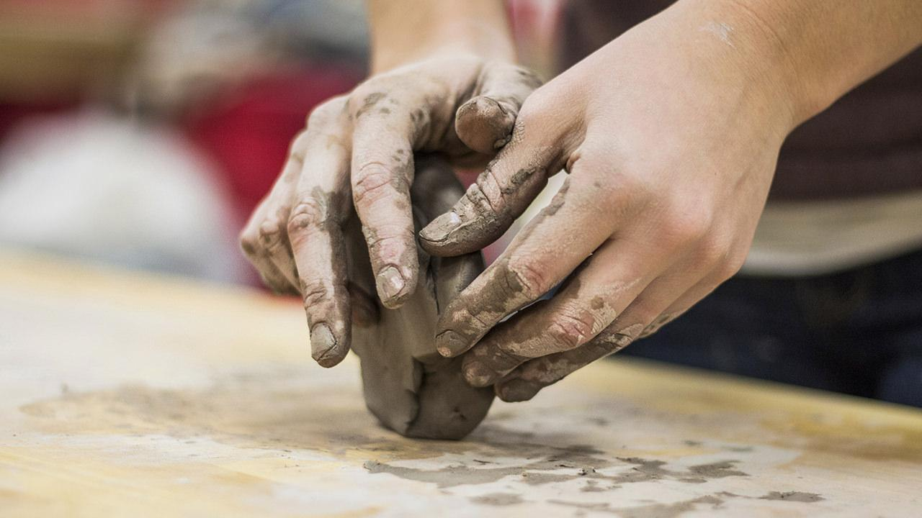
Understanding the platform
“
YouTube is the most popular and most used video platform in the world today. YouTube has a list of trending videos that are updated constantly.
”

Slide 4
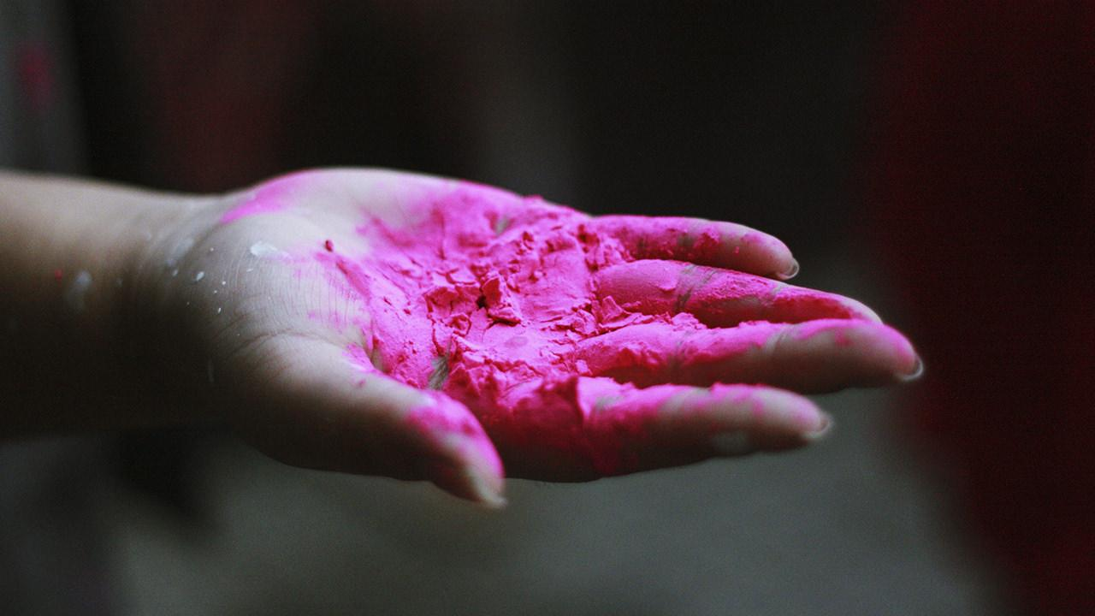
Hypothesis statement
Null Hypothesis:
Ho =. Videos released over the weekend have greater views on average than the ones released on weekdays.
Alternative Hypothesis:
Ha =. There’s no difference in viewership between videos released on weekdays and those released on the weekends

Slide 5

Research Question
We would like to know when it’s optimum to publish our videos so as to increase our viewership, brand awareness, social engagement and business development.

Slide 6
Goals

Slide 7

Goals
What's the best time of the day to publish our video
On which specific day should we upload our videos
What are the most common words and tags used in trending video titles?

Slide 8
13,810,252,879
Average weekly views

Slide 9

Social engagement
98% of the trendy videos had their comment sections enabled. This allowed for social engagement.

Slide 10

Nature of titles
From the analysis we noticed that 56% of the top trending videos included capital letters in their titles.

Slide 11

Prime hours
From the analysis done, we found out that the most opportune time to upload any video was from 4pm onward.

Slide 12

Views per day
Friday is the day with the most views

Slide 13

Commonality
Length
Trending videos have titles that are 33 - 60 characters long.
Titles & tags
The use of key symbols i.e hyphens and vertical bars.
Titles and Tags included common words.

Slide 14
Metric 1
Metric 2
Is there sufficient evidence to reject the null hypothesis
When is most suitable day to publish our videos.
Measuring success
Metric 3
Metric 4
What is common about the meta data in most trending videos.
What time of the day should you upload your videos.

Slide 15

Conclusion
Alternative Hypothesis:
Ha =. There’s no difference in viewership between videos released on weekdays and those released on the weekends

Slide 16
Recommendation
Publish periodic videos on Friday
Publicize content from 4pm everyday
Use titles that are 33-60 character long

Slide 17
Tom Kinyanjui
Patrick Mariwa
Group leader
Group member
TEAM MEMBERS
Marion Ndung’u
Wambui Kuria
Presenter
Group member

